Slide 1

Ericka Parker, MBA
EXECUTIVE INTEGRATOR | OPERATIONAL LEADER
Strategic Executive Support | Program & Business Operations | Process Improvement | People & Systems

Slide 2

WHO I AM
Executive Profile
Operational leader and executive partner with 10+ years of experience connecting people, processes, systems, and leadership priorities. Experienced in program and business operations, executive support, process improvement, team leadership, financial stewardship, and cross-functional coordination within complex, highly regulated environments.

Slide 3
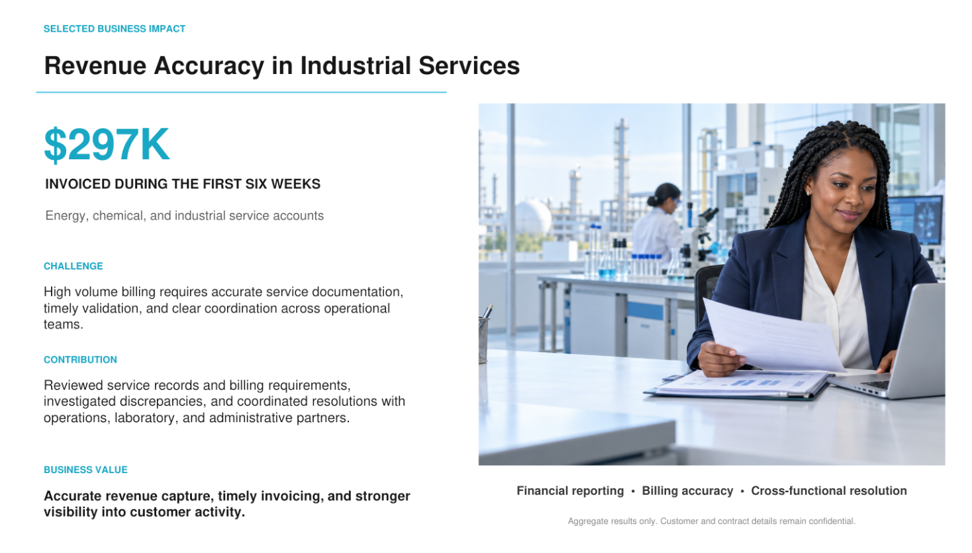

Slide 4

MY EXPERIENCE
Why I Am an Excellent Fit
Executive Partnership
Calendar Management
Executive Communications
Board Support
Confidential Information
Travel Coordination
Priority Management
Leadership Coordination
Business & Program Operations
Budget Stewardship
Process Improvement
SOP Development
Workload Planning
Cross-Functional Coordination
Compliance
Project Execution
Onboarding
Event Coordination
Billing Validation
Revenue Capture
Commercial Awareness
Systems & Technology
Microsoft 365
Excel
Power BI
Teams / SharePoint
Workday
SAP
Oracle / PeopleSoft
Microsoft Copilot
ChatGPT
Technology Adaptability

Slide 5
WHAT I BRING
Selected Business Impact
📈 Reduced processing time and rework through workflow standardization and clearer SOPs
💰 $750K Annual Budget Stewardship
👥 14 Team Members Led
📊 Executive KPI & Operational Reporting
🤝 Cross-functional leadership
⚙️ Process improvements
Supported several executive leaders at a time
to continue busy operations.

Slide 6

Executive Partnership
Complex calendar management
High-profile meeting coordination
Confidential correspondence
Executive travel
Board materials
Event planning
Priority management
Anticipating leadership needs

Slide 7

Technology and AI
Productivity Tools
Microsoft 365
Excel
PowerPoint
Outlook
Teams
SharePoint
Enterprise Systems
Workday
SAP
Oracle
PeopleSoft
Power BI
AI-Assisted Research Knowledge Synthesis
Process Documentation Executive Communications Workflow Optimization

Slide 8

HOW I WORK
HOW I OPERATE
🏢 Executive & Stakeholder Coordination
👥 Process Improvement
🔐 Scheduling & Capacity Planning
📦 SOP & Workflow Development
📬 Financial & Budget Administration
🖥 Cross-Functional Execution
🚨 Risk & Issue Resolution
📋 Technology Enablement
I bring structure to complex, fast-moving environments by connecting people, processes, systems and priorities—creating clarity, strengthening execution and helping teams move work forward.

Slide 9

HOW I OPERATE
Leadership Philosophy
I believe strong operational leaders create the structure that allows people and organizations to perform at their best. I lead through trust, accountability, organization and proactive communication—bringing clarity to complexity, anticipating needs and building systems that help teams succeed.

Slide 10

Professional Development
MBA
Google AI Essentials
Process Improvement
Cybersecurity
Diversity & Inclusion
Texas Notary

Slide 11

CONTACT / THANK YOU
Let’s connect
WHY I AM A GREAT FIT
NAME
Ericka Parker
Why You Can Count on Me
✓ Trusted Professional
✓ Executive Partner
✓ Calm Under Pressure
✓ Highly Organized
✓ Service-Oriented
✓ Continuous Learner
✓ Technology Forward
✓ Committed to Excellence
✓ Financially Accurate
EMAIL
Erickacparker@gmail.com
PHONE
+1 832 323 1952
Let's build something meaningful together.
I create clarity, strengthen operations and build trusted partnerships so leaders and teams can focus on what matters most.
I'm energized by opportunities to connect people, processes, systems and technology while helping organizations operate more effectively.
References and supporting documents available upon request.

